Slide 1
Assuring clients who store their data on public cloud
- From an Information Security Assurance Perspective

Slide 2
Team members
Name |  | Protocol / Device
Srikanth T | Divyesh Patel | HTTPS, SFTP
Shreyansh |  | SNMP
Shivani T | Mansi Somani | SSH
Krishna Chaitanya |  | Router
Saurabh Mishra |  | Firewall

Slide 3
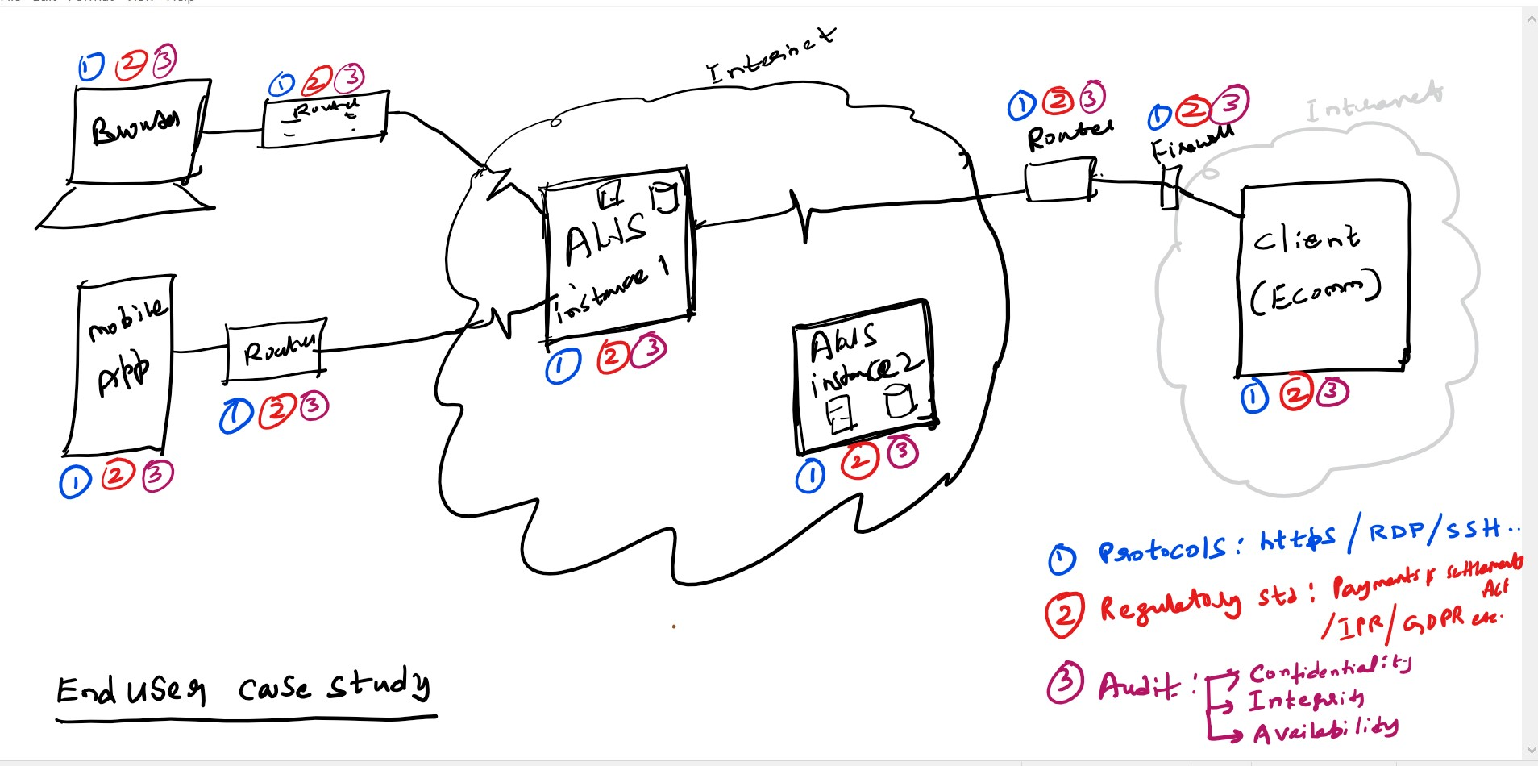
Information flow of a client’s data on public cloud

Slide 4
Our presentation is on protocols & devices and is organized into 3 sections
Vulnerabilities
How attackers carry out the attack
Mitigations

Slide 5
HTTPS: Vulnerabilities
Server Misconfigurations / Human Error:
Weak encryption settings
Eg. using outdated cipher suites, secure key generation, storage, etc.
Fraudulent or Expired Certificates:
Certificates from legitimate but compromised Certificate Authorities (CAs) to make fake websites appear authentic.
Fraudulent / Compromised Websites with Authentic Certificate
Zero-day Vulnerability
Mixed Content Vulnerability:
HTTPS page that loads the script over HTTP

Slide 6
HTTPS: How attackers carry out the attack
Exploiting Misconfigurations:
Eg. Brute force attack against weak encryption.
Deceptive websites with fake certificates appear legitimate to steal login credentials.
4. SSL stripping:
Unpatched vulnerabilities in TLS can be exploited.
5. Protocol Downgrade Attacks:
Attackers try to force a connection to use an older, less secure version of TLS/SSL that's easier to exploit.
MITM:
Downgrading HTTPS to HTTP on public Wi-Fi, followed by eavesdropping on unencrypted traffic

Slide 7
HTTPS: Mitigation
Use a VPN on Public Wi-Fi:
A Virtual Private Network (VPN) encrypts all your internet traffic, making it more secure on public Wi-Fi networks.
Check Website URLs:
Double-check the website address (URL) before entering sensitive information.
Be Wary of Phishing:
Don't click on suspicious links or trust unsolicited requests for personal information.
Software Updates:
Keep browser, operating system, and any security software are up-to-date with the latest security patches.

Slide 8
References:
https://www.cloudflare.com/learning/ssl/what-happens-in-a-tls-handshake/
https://www.infosecinstitute.com/resources/vulnerabilities/https-mixed-content-vulnerability/
https://wirexsystems.com/resource/protocols/https/

Slide 9
This slide is intentionally left blank

Slide 10
SFTP: Vulnerabilities
Weak Authentication Methods
Misconfigurations
incorrect file permissions
Brute-force Attacks (multiple login attempts)
Software Vulnerabilities
old s/w without applying security patches
Denial of Service (DoS) Attacks
https://nvd.nist.gov/vuln/detail/CVE-2024-20262
Inferior SFTP Protocols
weak encryption algorithms

Slide 11
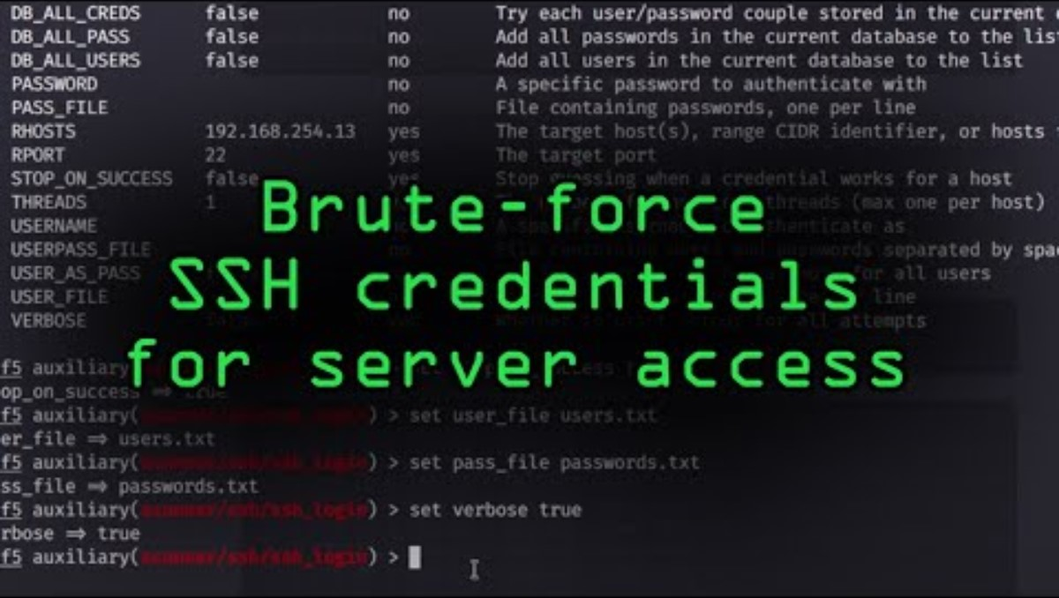
SFTP: How attackers carry out the attack
3. Brute-Force SSH Credentials to Gain Access to Servers

Slide 12
SFTP: Mitigation
Implementing Strong Authentication Methods
4. Regularly Updating and Patching SFTP Servers
SFTP Vulnerability Scanners for identifying Vulnerabilities 3, 5 and 6
Penetration testing using frameworks like Metasploit
Network Firewalls

Slide 13
SFTP: Distinct Advantages
Uses a single channel for digital communication whereas other protocols use multiple channels
Uses single port unlike FTPS that uses 2 ports (one for authentication and other for data transfer)
Relatively modern network protocol and builds on the highly flexible SSH communication mechanism
Meets most data governance and regulatory compliance requirements
Uses the Advanced Encryption Standard, or AES, to encrypt your data
Alert data recipients if external interference has altered the data using SHA-2

Slide 14
SFTP: References
https://www.kiteworks.com/secure-file-transfer/sftp-vulnerabilities/
https://www.spiceworks.com/tech/networking/articles/sftp-vs-ftps/
https://book.hacktricks.xyz/network-services-pentesting/pentesting-ssh
https://terrapin-attack.com/

Slide 15
This slide is intentionally left blank

Slide 16
SNMP: Vulnerabilities
Default Community Strings
Often set to defaults like "public" or "private," making unauthorized access simple for attackers who know these common strings.
Lack of Encryption
SNMP versions 1 and 2 do not encrypt data, allowing attackers to easily capture sensitive information transmitted over the network.
Insecure Configurations
Poorly secured settings and lax access controls can lead to unauthorized changes and access, compromising network integrity.
Reflection DDoS Attacks
SNMP can be exploited in reflection attacks to amplify malicious traffic toward a target, significantly disrupting services.
Unauthorized MIB Access
Accessing MIBs without authorization can reveal detailed information about network devices, providing a roadmap for further attacks.

Slide 17
SNMP: How attackers carry out the attack
Community String Guessing
Attackers use brute-force methods to guess weak or default community strings, gaining unauthorized access to network management functions.
Eavesdropping on SNMP Traffic
Without encryption, attackers can intercept SNMP communications, stealing data and even hijacking control of network devices.
Exploiting Configurations
By exploiting weak SNMP configurations, attackers can modify network settings or disrupt service, leading to potential downtime.
Amplification in DDoS Attacks
Attackers send SNMP requests with a forged source IP (the victim's address), prompting multiple devices to send large responses to the victim, overwhelming their network.
MIB Information Access
Unauthorized access to MIBs allows attackers to extract critical configurations and operational details, making targeted attacks easier.

Slide 18
SNMP: Mitigation for above attacks
Community String Guessing
Mitigation: Implement strong, unique community strings for SNMP. Avoid defaults like "public" or "private". Regularly rotate these strings and use a centralized management system for better control and distribution of updated credentials.
Benefit: Reduces the risk of unauthorized access through brute-force attacks on community strings.
Eavesdropping on SNMP Traffic
Mitigation: Encrypt all SNMP traffic using SNMPv3, which supports encryption out-of-the-box, or layer additional security with VPN tunnels or IPsec where SNMPv3 cannot be implemented.
Benefit: Ensures data confidentiality and integrity, preventing attackers from intercepting or tampering with SNMP communications.
Exploiting Configurations
Mitigation: Conduct regular audits and compliance checks of SNMP configurations. Use configuration management tools to enforce security policies and automatically rectify deviations from the baseline configuration.
Benefit: Maintains consistent security postures and prevents unauthorized changes that could lead to service disruption or vulnerabilities.
Amplification in DDoS Attacks
Mitigation: Restrict the use of SNMP to management networks or VPNs. Configure firewalls and routers to block incoming SNMP requests from untrusted sources, especially those originating from the internet.
Benefit: Minimizes the potential for SNMP to be used as a vector in DDoS attacks by controlling and limiting access to SNMP services.
MIB Information Access
Mitigation: Implement strict access controls on SNMP agents. Utilize SNMPv3's enhanced security features to control read and write access to MIB data. Monitor and log access to MIB information to detect and respond to unauthorized attempts.
Benefit: Protects sensitive network information contained in MIBs from unauthorized access and potential exploitation.

Slide 19
SNMP: Ensuring SNMP Security on Public Untrusted Networks (General Practices)
Use of SNMPv3 for Secure Management
Detail: Implement SNMPv3, which includes authentication, encryption, and access control mechanisms, ensuring that SNMP management traffic is secure and cannot be accessed by unauthorized entities.
Benefit: Guarantees that network management commands and data retrieved via SNMP are encrypted and authenticated, preventing data exposure and manipulation.
Encryption of SNMP Traffic
Detail: Apply strong encryption protocols (such as IPsec) to secure SNMP traffic between cloud-based devices and management consoles. This is crucial on public networks where interception risks are high.
Benefit: Protects SNMP data in transit from eavesdropping and tampering, ensuring that sensitive management operations remain confidential.
Access Control and Segmentation
Detail: Configure robust access controls to restrict who can communicate with SNMP agents. Use network segmentation within the cloud environment to separate management traffic from general cloud traffic.
Benefit: Reduces the risk of unauthorized access to SNMP management interfaces and limits potential damage from compromised network segments.

Slide 20
Mitigation Contd.
Monitoring and Anomaly Detection
Detail: Implement SNMP-specific monitoring and anomaly detection tools to identify unauthorized SNMP traffic or anomalous SNMP activities indicative of a security breach.
Benefit: Allows for rapid detection and response to security incidents, protecting network resources and client data integrity.
Regular Updates and Patch Management
Detail: Ensure all devices using SNMP are regularly updated and patched to defend against known vulnerabilities.
Benefit: Maintains the security integrity of SNMP-managed devices, preventing exploits based on outdated software or known flaws.
Compliance and Security Audits
Detail: Conduct regular audits of SNMP configurations and operations as part of your overall cloud security governance to ensure compliance with security policies and standards.
Benefit: Ensures that SNMP usage adheres to best practices and regulatory requirements, safeguarding client data and network operations.

Slide 21
This slide is intentionally left blank

Slide 22
SSH: Vulnerabilities
Terrapin Attack (CVE-2023-48795): It allows a malicious actor to downgrade the security of an SSH connection by manipulating data during the initial handshake process.
Reflected X11 Sessions: Reflected X11 sessions involve the redirection of graphical display output from a remote system to a local X server, often exploited for remote desktop access or monitoring.
SSH Banner Grabbing: SSH banner grabbing involves retrieving the SSH server banner, typically during the initial connection handshake, to gather information about the server's software version.
SSH Agent Hijacking: Involves exploiting the SSH agent forwarding feature, which allows a user to connect to another SSH server from an initial SSH session without re-entering credentials.
SSH Tunneling and Port Forwarding Abuse: SSH tunneling and port forwarding abuse involves leveraging SSH to create encrypted tunnels between systems and forwarding traffic, potentially bypassing network restrictions or accessing services without proper authorization.
SSH Root Logins: Enabling SSH root login poses a significant security risk because it allows direct access to the root account, which has unrestricted privileges on the system.

Slide 23
SSH: Vulnerabilities Contd.
Host Key Spoofing: Host key spoofing in SSH involves attackers forging or impersonating a server's host key to deceive clients into connecting to a malicious or unauthorized server.
Encrypted Key Extraction via Memory Dump: Encrypted key extraction via memory dump in SSH involves retrieving sensitive SSH keys stored in memory, typically through memory forensics or exploitation of vulnerabilities, to gain unauthorized access to remote systems.
Man-in-the-Middle (MitM) Attacks: SSH connections are susceptible to MitM attacks, where an attacker intercepts the communication between the client and server to eavesdrop or manipulate the data
Password-based Authentication: Reliance on password-based authentication without additional measures like multi-factor authentication (MFA) can make SSH vulnerable to password guessing attacks.
SSH Brute Force Attacks: Attackers may attempt to gain access to SSH servers by repeatedly trying different username and password combinations, exploiting weak or default credentials.
Weak Cipher Suites: The use of weak cipher suites in SSH can expose the communication to attacks such as brute-force cracking, where an attacker attempts to decrypt the communication by trying all possible keys.

Slide 24
SSH: How attackers carry out the attack
Terrapin Attack (CVE-2023-48795): In a Terrapin attack, a hacker intercepts the SSH handshake and hides strong encryption options from the client. Unaware, the client agrees to a weaker connection, allowing the attacker to potentially eavesdrop on communication. This works because the attack happens during the initial setup, before encryption is even applied.
Reflected X11 Sessions: Reflected X11 sessions occur when SSH is configured to forward X11 traffic, allowing users to run graphical applications over SSH. If an attacker gains access to a system with X11 forwarding enabled, they can exploit this by sending malicious X11 traffic back to the client's display
SSH Banner Grabbing: SSH banner grabbing involves establishing a connection to an SSH server and capturing the banner response, typically during the initial handshake. Attackers use this information to identify the SSH server version and potentially exploit known vulnerabilities associated with specific versions
SSH Agent Hijacking: The attacker exploits the situation by executing malicious commands or scripts on the compromised host where the SSH agent is running and has active forwarded connections.
SSH Tunneling and Port Forwarding Abuse: An attacker exploits SSH tunneling and port forwarding by first gaining access to an SSH account on a server, then setting up an SSH tunnel to redirect traffic from the compromised server to other network locations.

Slide 25
SSH: How attackers carry out the attack Contd.
SSH Root Logins: To exploit SSH root logins, an attacker typically begins by identifying a server with SSH service enabled where root logins are permitted. They then acquire the root password using methods such as brute force attacks, social engineering, or by stealing credentials from compromised databases. With the root credentials in hand, the attacker establishes an SSH connection to the server as the root user.
Host Key Spoofing: Host key spoofing in SSH involves an attacker setting up a rogue SSH server with a falsified or stolen host key that mimics a legitimate server, often facilitated by DNS spoofing to redirect network traffic. When clients attempt to connect to what they think is a legitimate server, they are instead directed to the attacker’s rogue server.
Encrypted Key Extraction via Memory Dump: This typically starts when an attacker gains unauthorized physical or remote access to a system, for example through malware or by exploiting a system vulnerability. Once inside, they use memory dumping tools to extract the contents of the system's RAM.
Insider Threats: Malicious insiders with legitimate access to the SSH server can abuse their privileges to carry out attacks, such as stealing sensitive data or disrupting operations.
Password Sniffing: Attackers can use packet sniffing tools to intercept SSH traffic and capture passwords sent in plaintext, especially if the server allows password-based authentication.

Slide 26
SSH: Mitigation
Terrapin Attack (CVE-2023-48795)
Upgrade: OpenSSH versions 9.6 and later have addressed the Terrapin Attack.
As a temporary workaround, you can disable the use of the "ChaCha20-Poly1305" cipher in affected SSH implementations.
Reflected X11 Sessions
Disable X11 forwarding unless absolutely necessary. If X11 forwarding must be enabled, use secure settings and trusted networks only.
SSH Banner Grabbing
Configure SSH servers to display minimal information in the banner. Keep SSH software up to date to reduce the risk of exploiting known vulnerabilities.
SSH Agent Hijacking
If SSH agent forwarding is required, limit its use to situations where you fully trust the remote system.
Ensure that machines which initiate SSH sessions are secure and well-maintained to prevent unauthorized access.

Slide 27
SSH: Mitigation Contd.
SSH Tunneling and Port Forwarding Abuse
Limit the use of SSH tunneling and port forwarding by using AllowTcpForwarding and PermitTunnel in the server's sshd_config file.
Implement monitoring on the SSH server to track when and how port forwarding is being used. Employ firewall rules to restrict incoming and outgoing connections on the SSH server.
SSH Root Logins
Instead of logging in as root, configure sudo for users who need to perform administrative tasks.
Strengthen SSH authentication by using key-based authentication instead of passwords.
Host Key Spoofing
Ensure strict host key verification practices are in place. Employ DNSSEC to protect against DNS spoofing that can lead to host key spoofing.
Encrypted Key Extraction via Memory Dump
ensure that sensitive data such as SSH keys are encrypted both at rest and in transit. Use operating system features that prevent or restrict access to raw memory.

Slide 28
Router: Vulnerabilities
Firmware Flaws:
Outdated firmware can contain unpatched vulnerabilities that may be exploited by attackers.
Misconfiguration:
Improperly configured routers can expose the network to unauthorized access and attacks.
Routing Table Poisoning:
Routing poisoning can cause incorrect data being added to the routing table which results in disrupting network flows.
Open Ports:
Unnecessary open ports can serve as entry points for malicious activities which are found using Port Scanning tools.

Slide 29
Router: How attackers carry out the attack
Packet Mistreating:
It injects packets with malicious codes designed to confuse and disrupt the router and network with the intention of confusing the router and make it slow.
Credential Stuffing:
Using default or stolen credentials to gain unauthorized access to the router’s admin settings.
Exploiting Firmware Vulnerabilities:
Installing malware or creating backdoors by taking advantage of security holes in outdated firmware.
Man-in-the-Middle Attacks:
Intercepting and manipulating traffic between the router and connected devices by exploiting weak encryption.
Denial of Service (DoS):
Overwhelming the router with excessive requests, causing it to crash or become unresponsive.

Slide 30
Router: Mitigation
Regular Firmware Updates:
Regularly check for and install firmware updates from the router manufacturer to patch vulnerabilities.
Proper Configuration:
Ensure the router is configured correctly, including disabling features not in use, and restricting access to the admin interface.
Conduct Regular Security Audits:
Periodically review security settings and configurations to identify and mitigate risks.
Disable Remote Management:
Turn off remote management features to prevent access to the router’s administrative settings from outside the network.

Slide 31
Firewall: Vulnerabilities
Misconfigured Rules: Top Vulnerability: Weak or overly permissive rules are the most common firewall vulnerability, often due to human error or a lack of understanding of network traffic.
Outdated Software: Unpatched vulnerabilities in outdated firewall software leave exploitable weaknesses for attackers.
Insider Threats: Disgruntled employees or compromised accounts with firewall access can manipulate rules for malicious purposes.
Evasion Techniques: Sophisticated attackers might use techniques like tunneling or protocol obfuscation to bypass firewall filters and infiltrate the network.

Slide 32
Firewall: How attackers carry out the attack
Rule Exploitation: Attackers can exploit loopholes or misconfigurations in firewall rules to gain unauthorized access to specific resources.
Software Exploitation: Known vulnerabilities in outdated firewall software can be targeted for privilege escalation or complete system compromise.
Social Engineering: Attackers might trick authorized personnel into granting temporary access or modifying firewall rules in their favor.
Advanced Persistent Threats (APTs): Highly targeted attacks may leverage a combination of social engineering, malware deployment, and zero-day exploits to bypass firewalls and establish a persistent presence within the network.

Slide 33
Firewall: Mitigation
Strict Rule Management: Implement a rigorous process for firewall rule creation, review, and approval. Conduct regular audits to ensure all rules are necessary, up-to-date, and secure.
Continuous Updates: Maintain the firewall software and firmware with the latest security patches from the vendor to address known vulnerabilities promptly.
Granular Access Controls: Restrict firewall configuration access with strong authentication protocols (MFA) and the principle of least privilege. Monitor for suspicious activity related to rule changes.
Advanced Threat Detection: Deploy intrusion detection and prevention systems (IDS/IPS) to monitor for anomalous traffic patterns that could indicate firewall evasion attempts.

Slide 34
Firewall: Security on Public Cloud Environments
Next-Generation Firewalls (NGFWs): Utilize NGFWs that offer deep packet inspection, application-level control, and integrated intrusion prevention to detect and block sophisticated threats beyond traditional port and protocol filtering.
Zero Trust Network Architecture (ZTNA): Implement a ZTNA model that requires continuous authentication and authorization for all users and devices, regardless of location, before granting access to resources. This minimizes the impact of compromised credentials or social engineering attacks.
Cloud-Native Firewall Solutions: Leverage cloud-native firewall solutions specifically designed for the dynamic nature of cloud environments. These solutions can automatically scale with deployments and consistently enforce security policies across all cloud resources.
Traffic Encryption: Encrypt data transmissions between cloud resources and on-premises environments to protect against eavesdropping and man-in-the-middle attacks, ensuring data confidentiality and integrity.
Regular Penetration Testing: Conduct periodic penetration testing and red team exercises to identify potential weaknesses in firewall configurations and rule sets. This proactive approach provides valuable insights into the effectiveness of your firewall security posture.

Slide 35
Firewall: Key Improvements
Prioritized Vulnerabilities: Identifies misconfigured rules as the top vulnerability, highlighting its criticality.
Focus on Cloud Security: Tailors mitigation strategies to the public cloud environment, emphasizing cloud-native solutions and ZTNA.
Actionable Mitigations: Provides specific actions for each mitigation strategy, making it easier to implement.
Emphasis on Threat Detection: Highlights the importance of advanced threat detection with NGFWs and IDS/IPS for comprehensive security.

Slide 36
Thankyou

